Slide 1
Advance
Artificial Intelligence (AIS)
Dr. Drs. Taswanda Taryo, M.Eng.Sc.
Program Magister Teknik Informatika
Universitas Pamulang
Feb.-March 2023

Slide 2
My Short CV
Born, March 28, 1956
1. Education: Physics, ITB, 1976-1981,
2. Univ. New Brunswick, Canada, M.Sc. in Chem. Eng.,
1989-1991,
3. Doctor in Computation, UGM, 1998-2003,
Cum Laude.
Joined BATAN November 1981;
A. Div. Manager of Reactor Technology, 1992
B. Director of Safeguards Tech. Center, 2005
C. Director of Nuclear Safety and Rect. Techn. Center, 2006
D. Director of Dissemination Center, 2006-2008

Slide 3
My Short CV
E. Deputy Chairman for Dissemination of NST, 2008-2011
F. Secretary General, 2011-2014
G. Deputy Chairman of NET, 2014-March 2016
H. Member of National Energy Council (DEN),
Jan.-Dec., 2014
I. President Commissioner of PT INUKI,
August 2011-March 2016.
J. Part -Timer Lecturer for S-2, Saturday/Sunday
Since 2003-Now.
K. CEO of Project Management Office for Indonesia Exp. Power Reactor, April 2016-Dec. 2017.
L. Sen. Researcher at BATAN, Jan 2018-April 2021.
M. Full Unpam Lecturer Since April 2021.
At least 82 Papers for National and International Seminars, Conferences and Journals.

Slide 4
GRADING
Minimum Kehadiran 75%
KEHADIRAN 10%,
TUGAS/PRESENTASI: 20%
2. UTS: 30%
3. UAS: 40%

Slide 5
GRADING
1. KEHADIRAN 10% (100 bila 14x Hadir)
2. TUGAS 20%
(60% Nilai Tugas Mingguan 14X +
40% Nilai Presentasi)
3. UTS: 30%
4. UAS: 40%

Slide 6
JADWAL KULIAH
FINAL EXAM: 05 July 2023
KULIAH PRE-UTS:
22/02; 01/03; 08/03
15/03; 22/03; 29/03; 03/05
ME/UTS: 10 May 2023
KULIAH PRE-UAS:
17/05; 24/05; 31/05
07/06; 14/06; 21/06; 28/06

Slide 7
PRESENTATION
      1. Duration 10 minutes (2),
      2. Paper Assessment,
      3. Grading: Content, Time and
      Presentation’s Style,
      4. Presentation can be
      in Bahasa or in English,
      5. If in English, ”BONUS 5” will be rewarded for Final Exam
Badan Tenaga Nuklir Nasional

Slide 8
4 Steps to Be A Good Life
1. To Have A Vision,
2. To Be Focused and Sustain,
3. Be Honest and Always
To Be A Giver and
4. Be Prayed to Allah and Ask Pray from Your Parents.

Slide 9

Nuclear for
Country Prosperity
UNPAM Tangsel, February 2023

Slide 10



Status of NPPs in the Globe
449
Operation
52
In-progress construction
398.887 MWe
On-power capacity
USA
96 reactor
97565 MWe
2 reactor
France
58 reactor
63130 MWe
1 reactor
China
48 reactor
44518 MWe
9 reactor
Japan
37 reactor
35947 MWe
2 reactor
Russia
36 reactor
28355 MWe
6 reactor

Slide 11
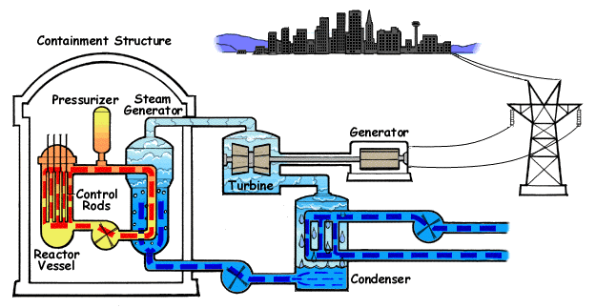

Slide 12
WHY
NPP ?
EFFICIENT
RELIABLE
CLEAN

Slide 13
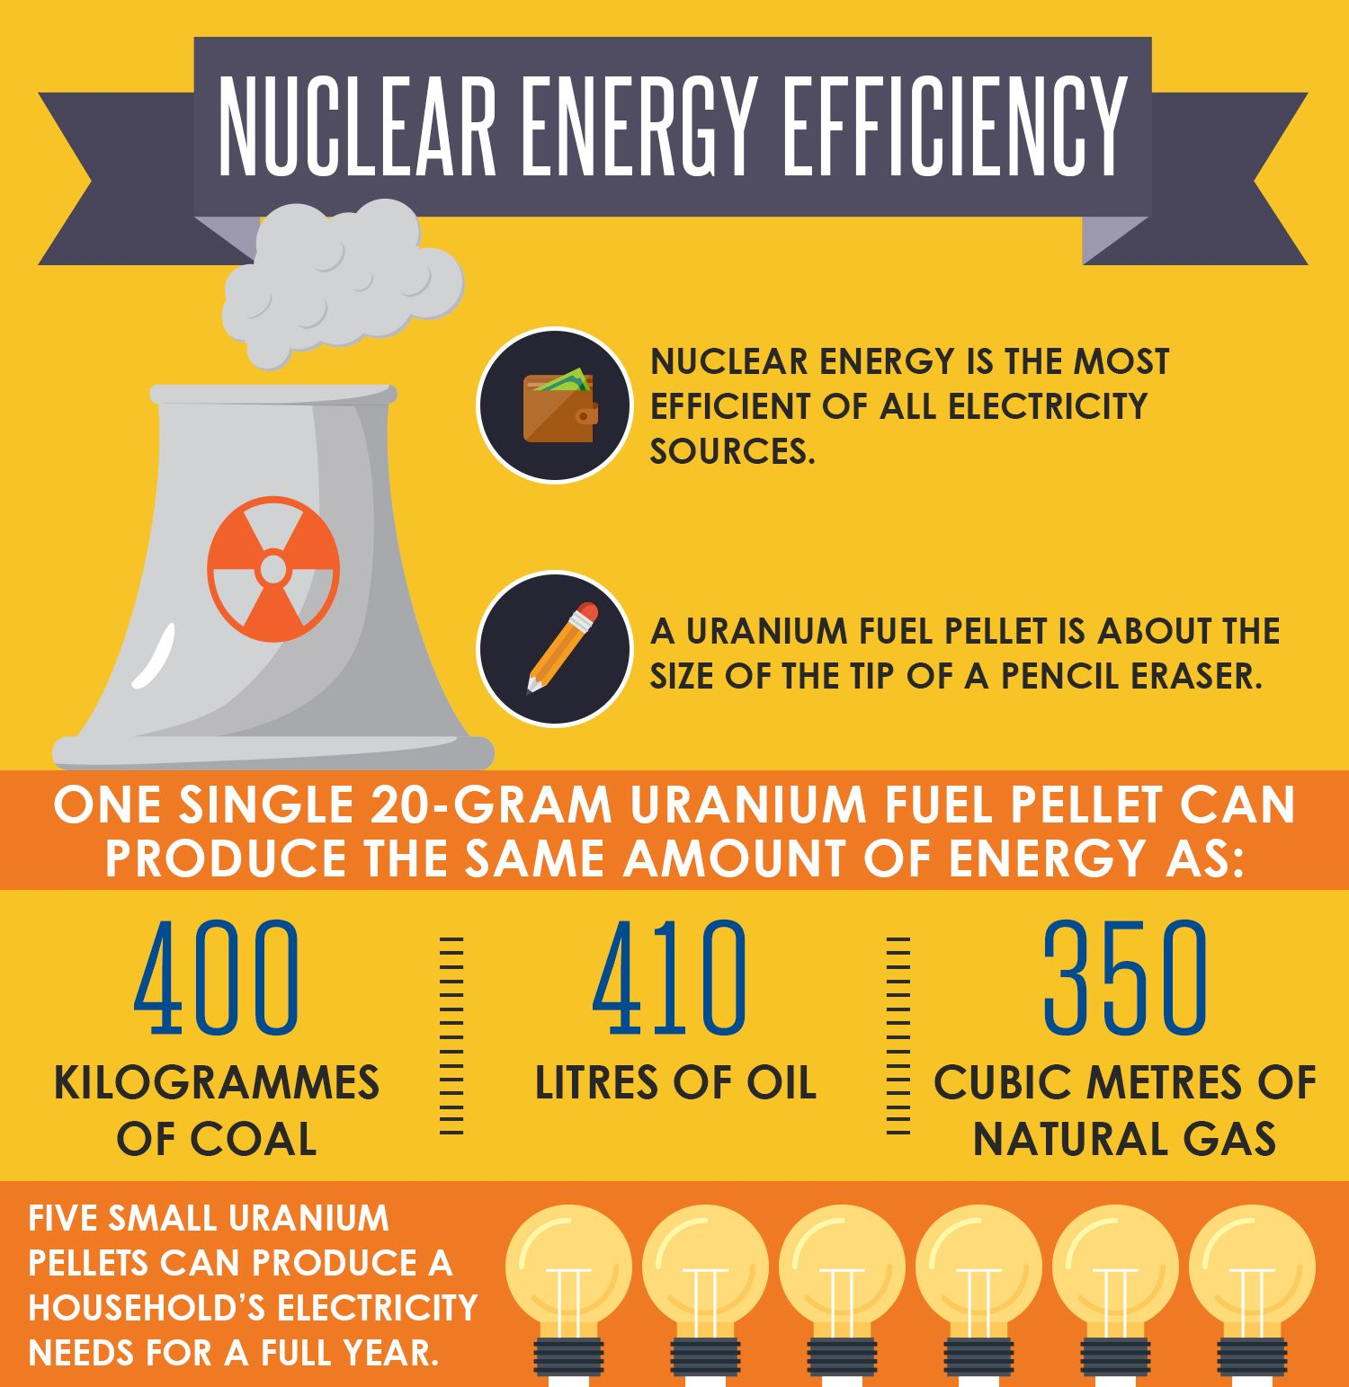
Fuel Comparative

Slide 14
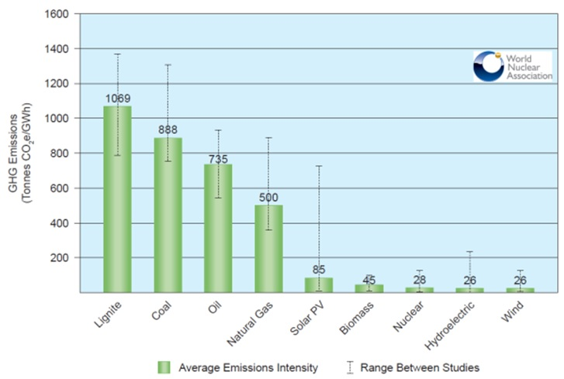
Carbon Emission Comparative

Slide 15
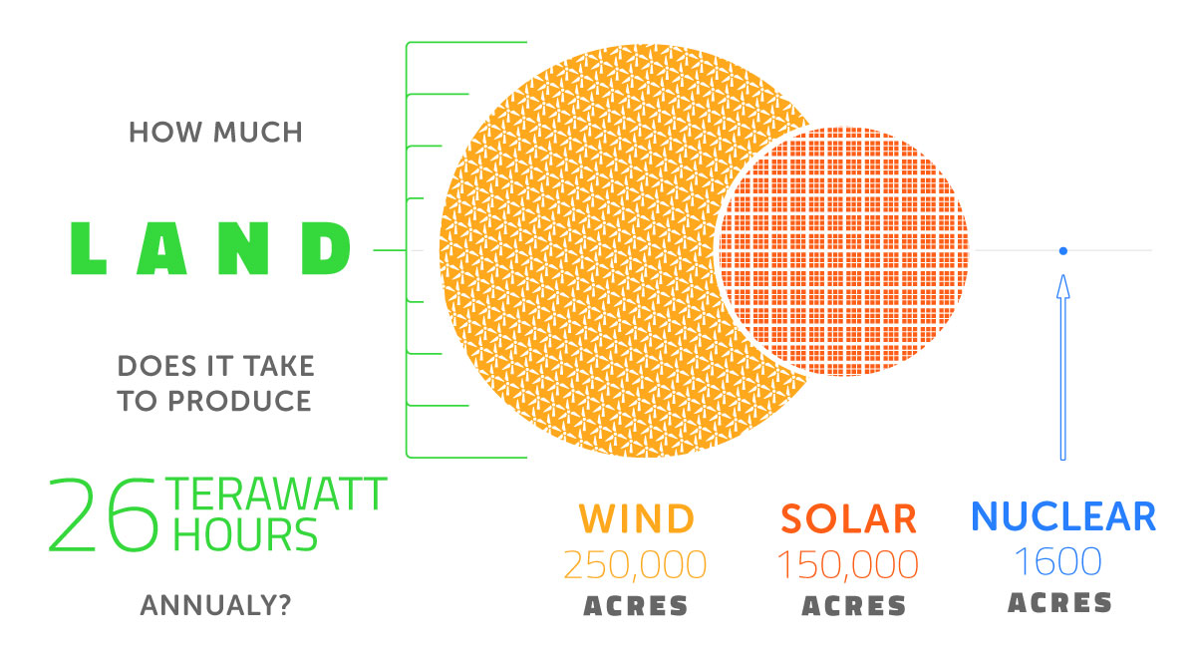
Land Need for Site

Slide 16
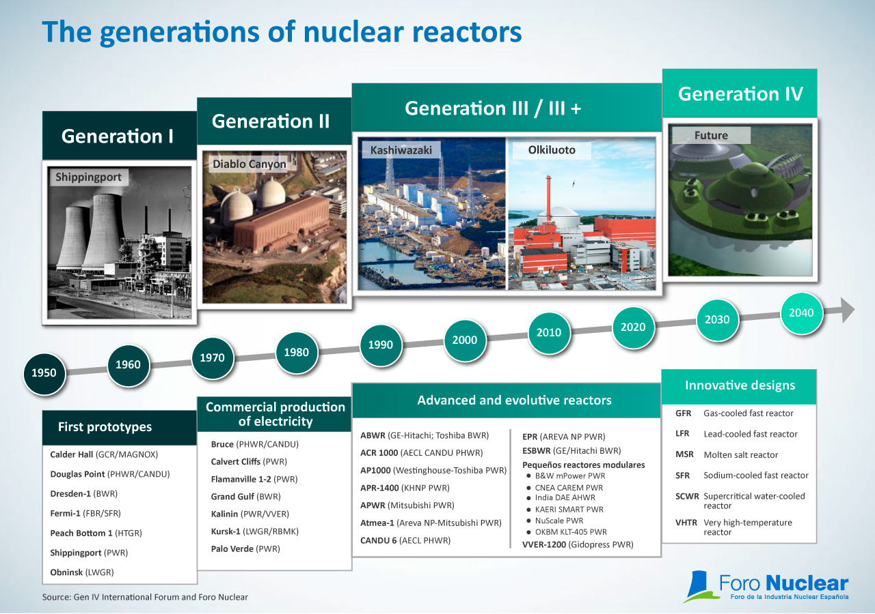
NPP Technology Development

Slide 17







Public Acceptance in Indonesia
59.70%
49.50%
52.90%
60.40%
72.00%
75.30%
77.53%
2010
2011
2012
2013
2014
2015
2016
Sustainable Energy
Renewable Energy
Friendly Environment
Technology Guarantee
Risk and Safety
High Cost Investment
Geopolitics Resistance
Public Acceptance

Slide 18
THANK YOU
ANY QUESTION?

